Slide 1
Project on Renewable Energy Source: Solar Energy
Name
Course
Institution of Affiliation

Slide 2
Introduction
Energy sources could get exhausted if they are non-renewable.
Some of the sources are often associated with environmental pollution, for example, burning of fossil fuels.
Fossil fuels have been the main contributor to the greenhouse effect and the depletion of the ozone layer.
With the fossil fuels being limited, the gas price has risen in the last few years and this has elicited the need to switch to renewable sources of energy.
Renewable energy sources are replenished regularly on a human timescale.
Renewable energy sources could offer energy for use in four key areas; electricity, air and water cooling or heating, transportation, and off-grid energy sources.
Solar energy is alternative energy source that is renewable and could facilitate the production of energy for household and commercial use.

Slide 3
What can Solar Energy be used for?
Solar technologies convert solar energy into electrical energy by using photovoltaic panels or mirrors that concentrate solar radiation.
This energy can be stored in batteries for various uses include:
    Heating homes and cooking.
    Driving motor engines
    Driving production plants in industries.
    Household and street lighting.

Slide 4
How is Solar Energy Easily Renewed?
Sunlight is unlimited and cannot be exhausted.
Solar energy is clean green electricity sourced from sunlight.
All people need to do is install solar power systems such as solar photovoltaic or a solar thermal system on the roof.
It is a renewable free source of energy that is sustainable and totally inexhaustible, unlike fossil fuels that are finite.
It is also a non-polluting source of energy and it does not emit any greenhouse gases when producing electricity.

Slide 5
Cost of Using Solar Energy
The cost associated with using solar energy include the installation of solar panel systems and maintenance.
The cost of solar panels is calculated using dollars per watt.
In 2018, the average cost of solar panels installation for household use was in the range of $2.87 and $3.85 per watt.
The average installation cost before tax credit is $16,800.
If a household want an installation of 5 kilowatts, the cost would be in the range of $10,045 to $13,475 after tax credits (Atwell, 2018).

Slide 6
Positive Aspects of using Solar Energy
Solar energy is free of pollution and does not emit any greenhouse gas after installation.
Besides, it contribute to reduced dependence on fossil fuels.
It is a renewable energy source that is readily available.
It can be used for diverse purposes; you can generate hear (solar thermal or electricity (photovoltaic).
It offers a cheap source of electricity in areas that are not covered by the energy grid, distil water in areas with limited clean water supply and power satellites in space.

Slide 7
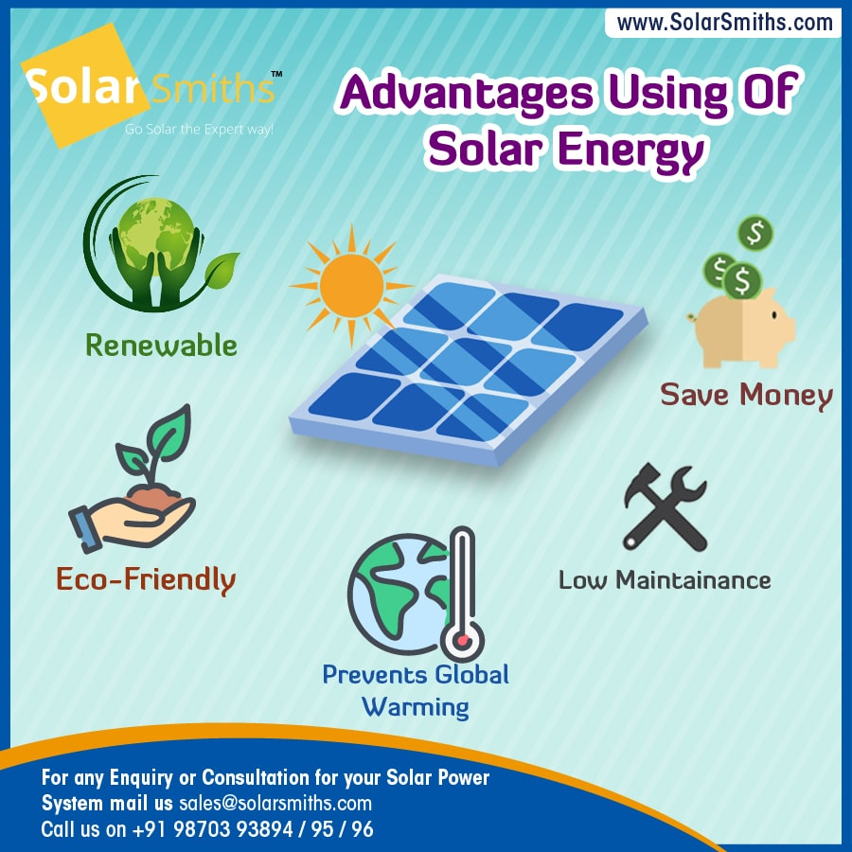

Slide 8
Negative Aspects of Using Solar Energy
The initial installation of the solar system is relatively high; it includes purchasing wires, batteries, inverters, and solar panels.
Although it can be used even during cloudy or rainy days, the efficiency of the solar system reduces because it is dependent on sunlight to effectively gather energy.
Large scale installation of solar panels can lead to habitat loss and land degradation.
The facilities require large plots, which could interfere with mineral production, wilderness areas, and protected areas.
While commercial installation of solar panels is subsidized by the government, it leads to an increase in the cost of electricity generated; this cost is transferred directly to taxpayers through utility bills.

Slide 9
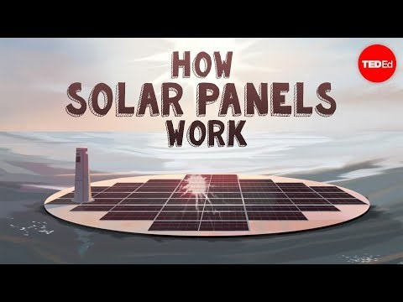

Slide 10
Science Behind Solar Energy
Solar energy is captured using photovoltaic cells.
Sunlight lands on the solar panels and produce an electric field.
The electricity produced on the panels flows to the edge of the panels and enter a conductive wire.
This wire take the electricity to an inverter, which convert the DC current to AC. Another wire transports the AC current from the inverter to the electric panel of a building , which then distributes the power around the building as needed.
It passes through the utility meter and into the utility electrical grid.
The utility meter records any excess generation, which is subject to a bill payment.

Slide 11
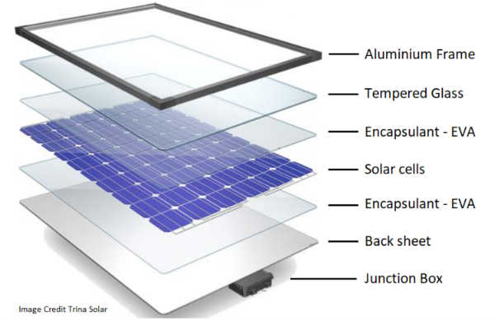
Notes:
Components of solar photovoltaic panel.

Slide 12
Science Behind Solar Energy Cont…
Solar Photovoltaic panels are comprised of many small photovoltaic cells , which can transform solar energy to electricity.
The cells are made of semi-conductive material, such as silicon so that they can conduct electricity while maintaining the electrical imbalance necessary to generate an electric field.
Most electricity consumers use alternating current contrary to the direct current produced by solar panels.
The inverter makes the electricity accessible for household use by converting it from DC to AC, which is now ready to power appliances, lights, and other electrical components.

Slide 13
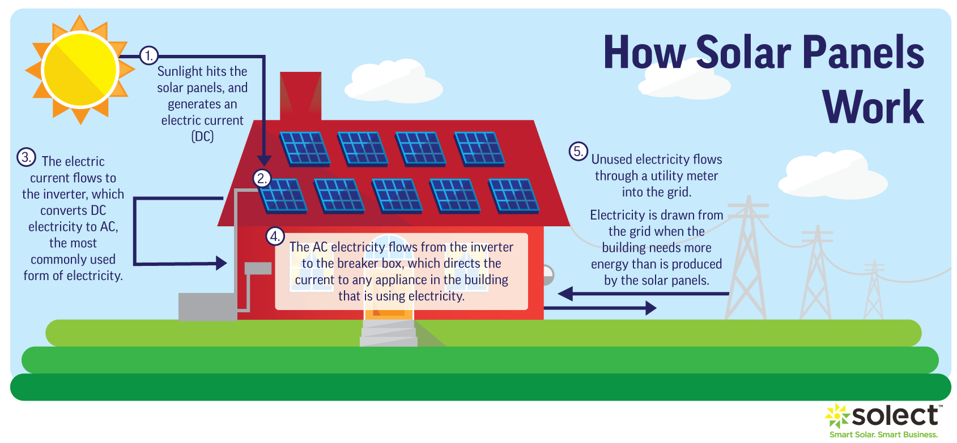
Notes:
When sunlight hits the semiconductor in the solar PV cell as seen in step 1, the energy from the light, in the form of photons, is absorbed, knocking loose a number of electrons, which then drift freely in the cell. The solar cell is specifically designed with positively and negatively charged semiconductors sandwiched together to create an electric field. This electric field forces the drifting electrons to flow in a certain direction- towards the conductive metal plates that line the cell. This flow is known as an energy current, and the strength of the current determines how much electricity each cell can produce. Once the loose electrons hit metal plates, the current is then directed into wires, allowing the electrons to flow like they would in any other source of electric generation as seen in step 2.

Slide 14
When the Solar Energy is Expected to be easily accessible to the general public?
While solar energy is alternative energy source that help fight climate change, there are by products in the production of solar panels that limit this capability.
The production emits many greenhouse gases and other toxic waste.
Fossil fuels are a cheaper energy source than solar with 39 percent of energy in the United States coming from coal while solar energy sources only account for 0.3 percent.
It is unclear when solar energy use will become popular in the United states.
However, the consumption is expected to rise to 20 percent by 2027 and by 2050, the energy source will be easily available to every household.

Slide 15
References
Atwell, C. (2018). The True Cost of Solar Energy. Power Electronics. Retrieved from https://www.powerelectronics.com/technologies/alternative-energy/article/21864098/the-true-cost-of-solar-energy
Office of Energy Efficiency and Renewable Energy (n.d.). How Does Solar Work? Retrieved from https://www.energy.gov/eere/solar/how-does-solar-work
Vourvoulias, A. (2021). Pros and Cons of Solar Energy. Greenmatch. Retrieved from https://www.greenmatch.co.uk/blog/2014/08/5-advantages-and-5-disadvantages-of-solar-energy

